Slide 1
( Automated estimation of vehicle CO₂ emissions (g/km) based on vehicle specifications)
CO₂ Emission Prediction Project

Slide 2
Mentor & Team Members
Mentor Name : KARTHIK
Team Members: DEGA RAMBABU
KURAVA RAVI KUMAR
GIRIDHAR KALKERI
SUSHANT SINGH
JULLA NAVEEN KUMAR
MOHAMMAD JAWAD M A

Slide 3
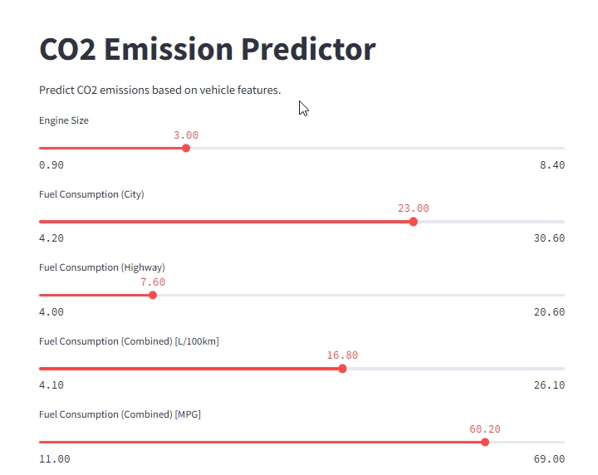
Prediction Video

Slide 4
Project Objective
Model CO₂ emissions as a function of vehicle attributes to understand drivers of emissions and enable prediction for new vehicles.
Target variable: CO₂ emissions (g/km).

Slide 5
Dataset Details
Source: Uploaded CSV (co2_emissions.csv). Rows: 7385 | Columns: 12.
No. of missing values (total): 0
Key variables include: engine size, cylinders, transmission, fuel type, fuel consumption (city/hwy/combined), make/model, and CO₂ emissions.

Slide 6
Exploratory Data Analysis — Key Inferences
CO₂ emissions — mean: 250.6 g/km, median: 246.0, min: 96.0, max: 522.0.
No missing values detected in the dataset (consistent with dataset overview).
Strong positive relationships observed between fuel consumption (L/100km) and CO₂ emissions; engine size also positively correlated with CO₂.

Slide 7
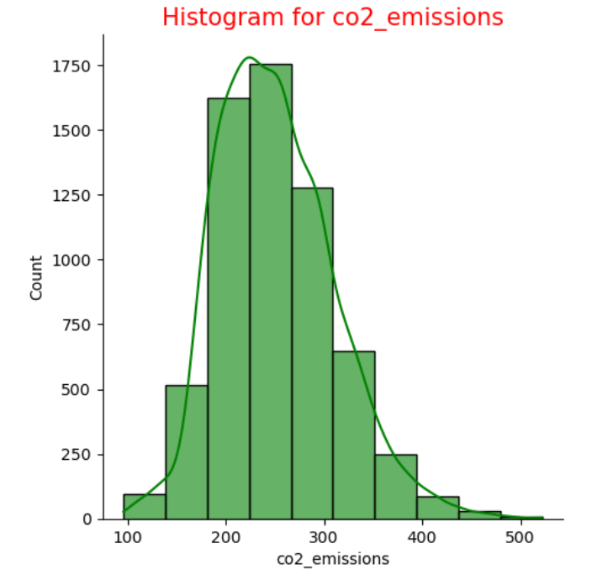
EDA — CO₂ Distribution
Histogram showing distribution of CO₂ emissions across vehicles.

Slide 8
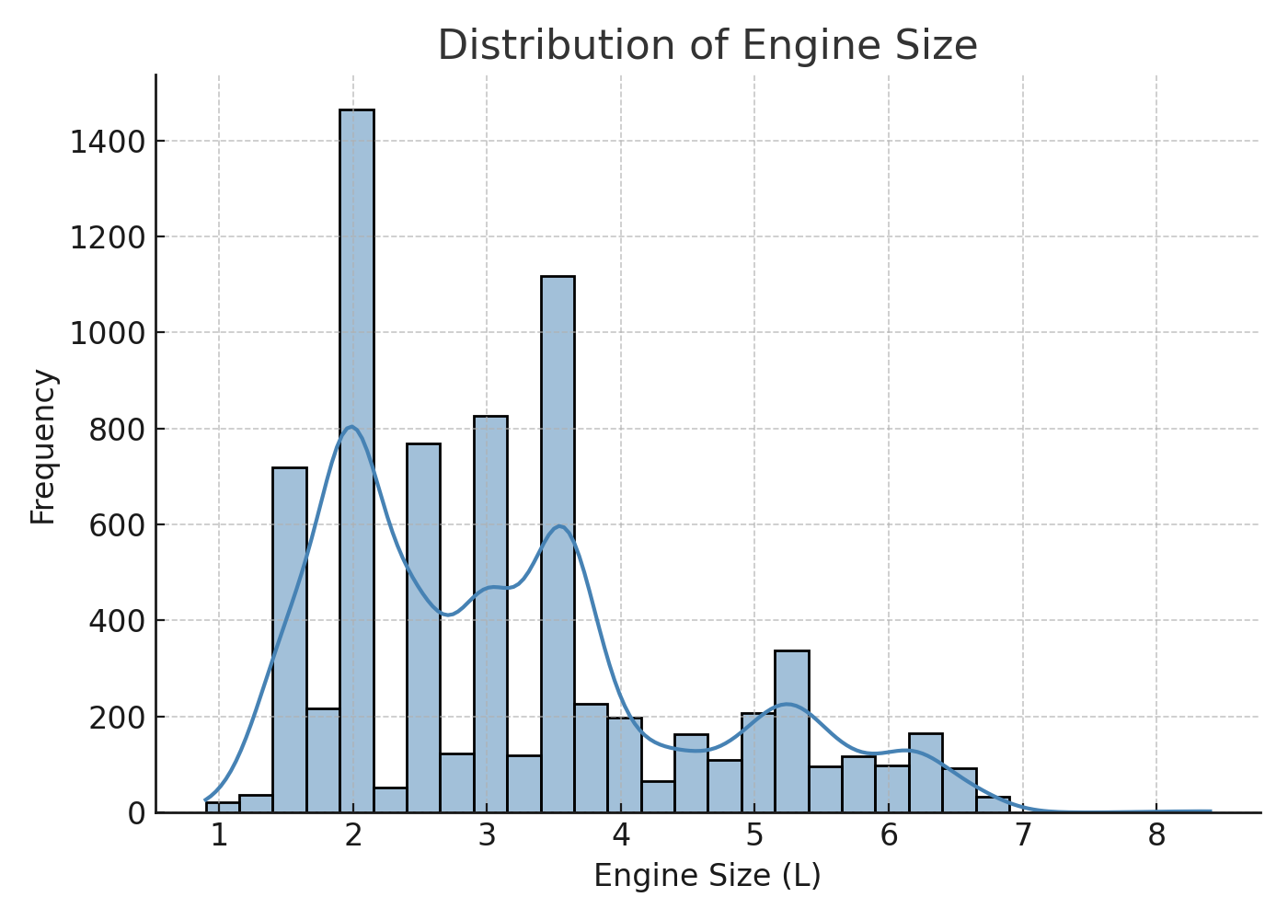
EDA — Engine Size Distribution
Histogram / density plot of engine sizes.

Slide 9
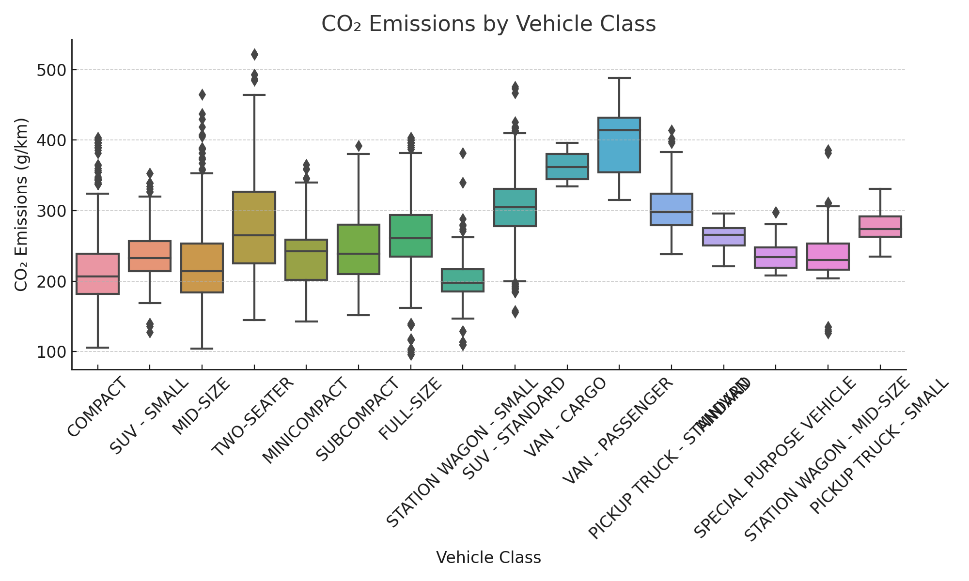
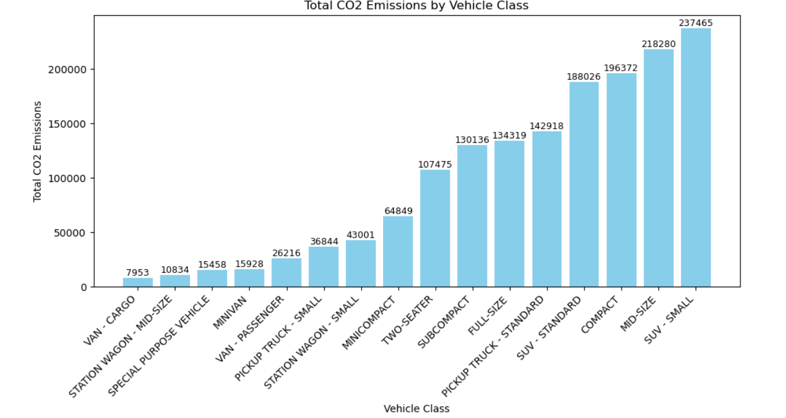
EDA — CO₂ by Vehicle Class
Boxplot of CO₂ emissions across vehicle classes (SUV, Compact, etc.).

Slide 10
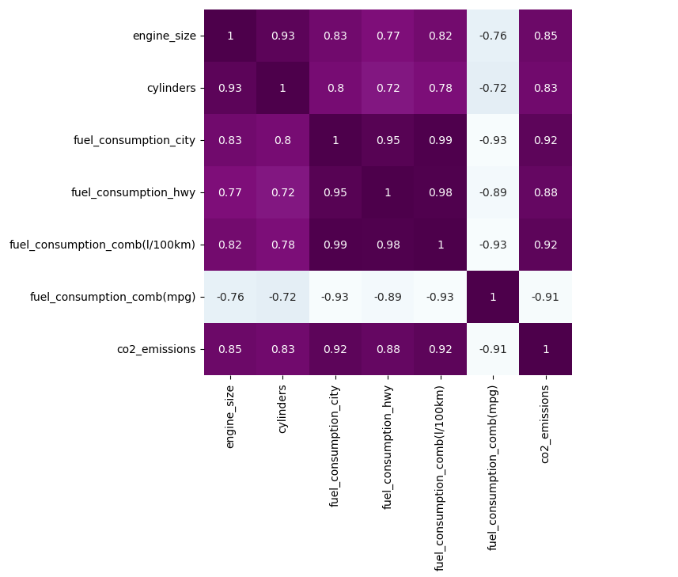
EDA — Correlation Heatmap
Correlation between numeric features and CO₂ emissions.

Slide 11
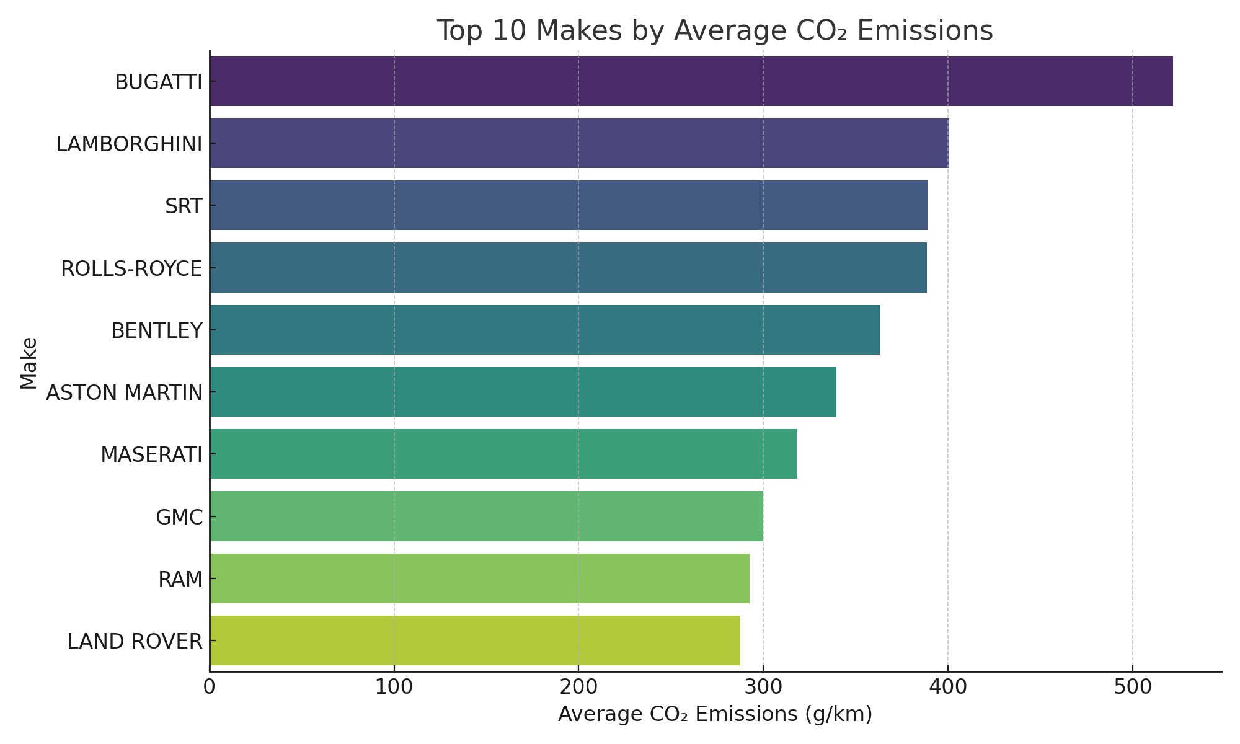
EDA — Top Makes by Avg CO₂
Top 10 manufacturers with highest average CO₂ emissions.

Slide 12
Modeling Approach — Overview
Baseline models: Linear Regression (baseline) and Random Forest Regressor (ensemble).
Preprocessing: selected numeric features + one-hot encoding for key categoricals; train/test split (80/20).
Evaluation metrics: R², RMSE, MAE.

Slide 13
Features Used for Modeling
engine_size, cylinders, fuel_consumption_city, fuel_consumption_hwy, fuel_consumption_comb(l/100km), fuel_consumption_comb(mpg), fuel_type_E, fuel_type_N, fuel_type_X, fuel_type_Z, transmission_AM, transmission_AS

Slide 14
Baseline Model — Linear Regression (Test Set)
R²: 0.990
RMSE: 5.868 g/km
MAE: 3.143 g/km
Interpretation: Linear regression gives a baseline performance; non-linear models may capture feature interactions better.

Slide 15
Random Forest (Default) — Test Set
R²: 0.996
RMSE: 3.816 g/km
MAE: 1.909 g/km
Random Forest improved performance vs. linear baseline.

Slide 16
Final Model — Selected for Deployment
Model: Random Forest Regressor (n_estimators=100).
Test R²: 0.996 | RMSE: 3.816 g/km | MAE: 1.909 g/km
Reason: good predictive performance and simple to deploy as a lightweight service.

Slide 17
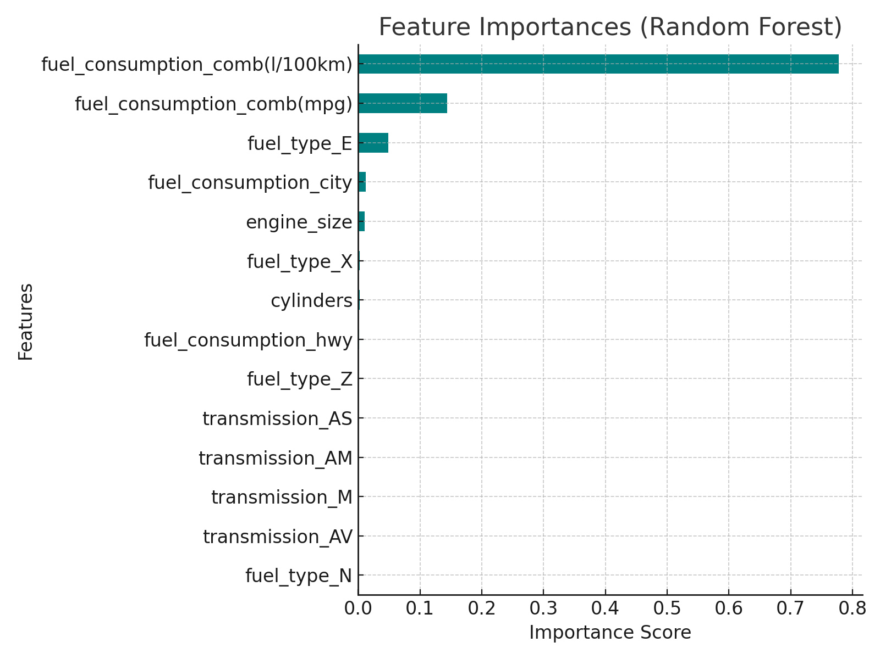
Feature Importance — Top Contributors
1. fuel_consumption_comb(l/100km) — importance 0.7775
2. fuel_consumption_comb(mpg) — importance 0.1438
3. fuel_type_E — importance 0.0484
4. fuel_consumption_city — importance 0.0120
5. engine_size — importance 0.0105
6. fuel_type_X — importance 0.0023
7. cylinders — importance 0.0023
8. fuel_consumption_hwy — importance 0.0019

Slide 18
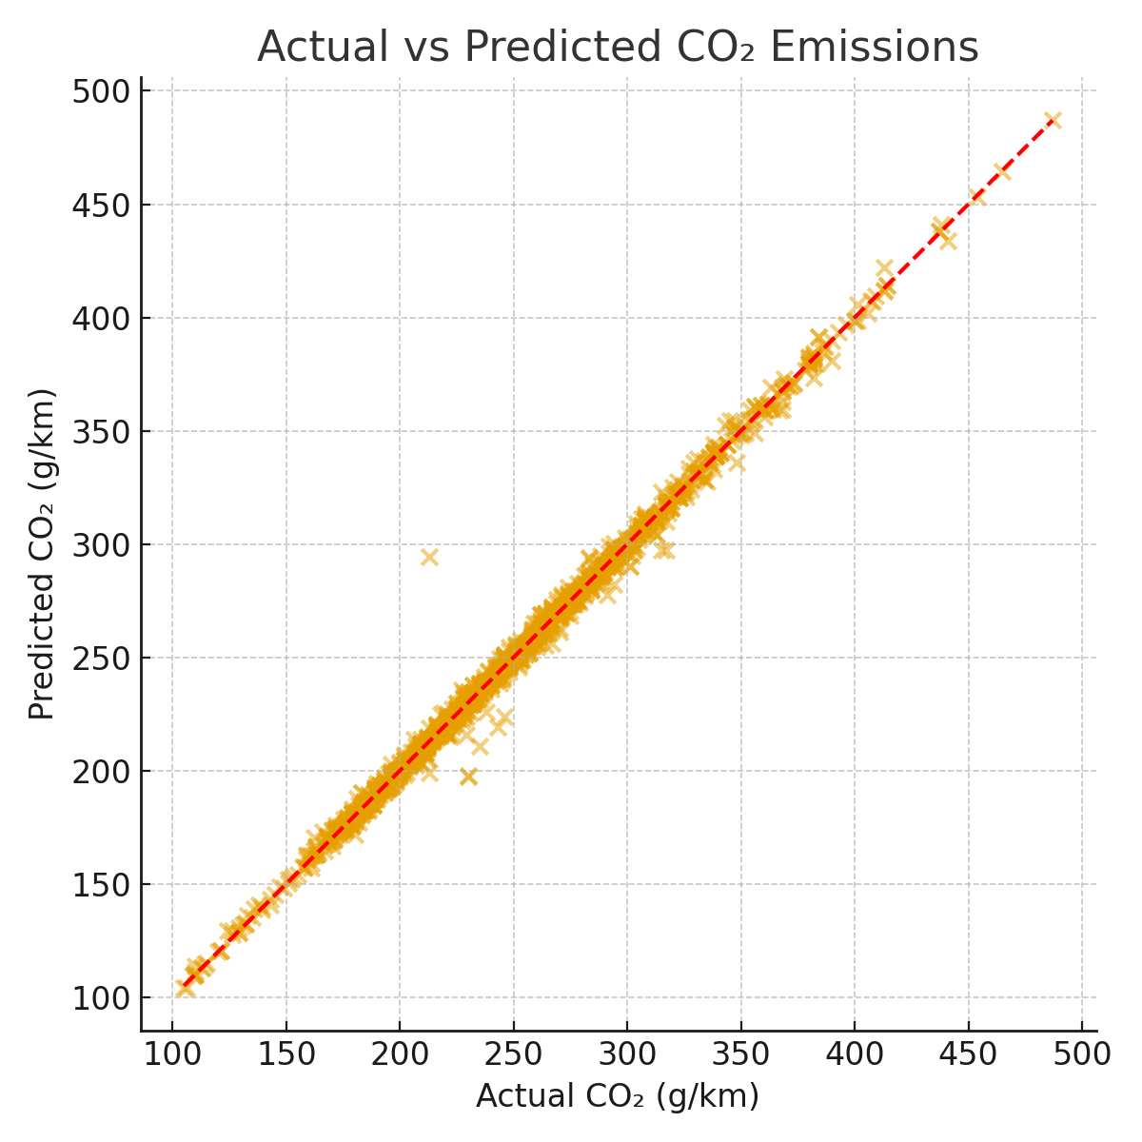
Evaluation — Predictions vs Actual
Scatter plot of actual vs predicted CO₂ values.

Slide 19
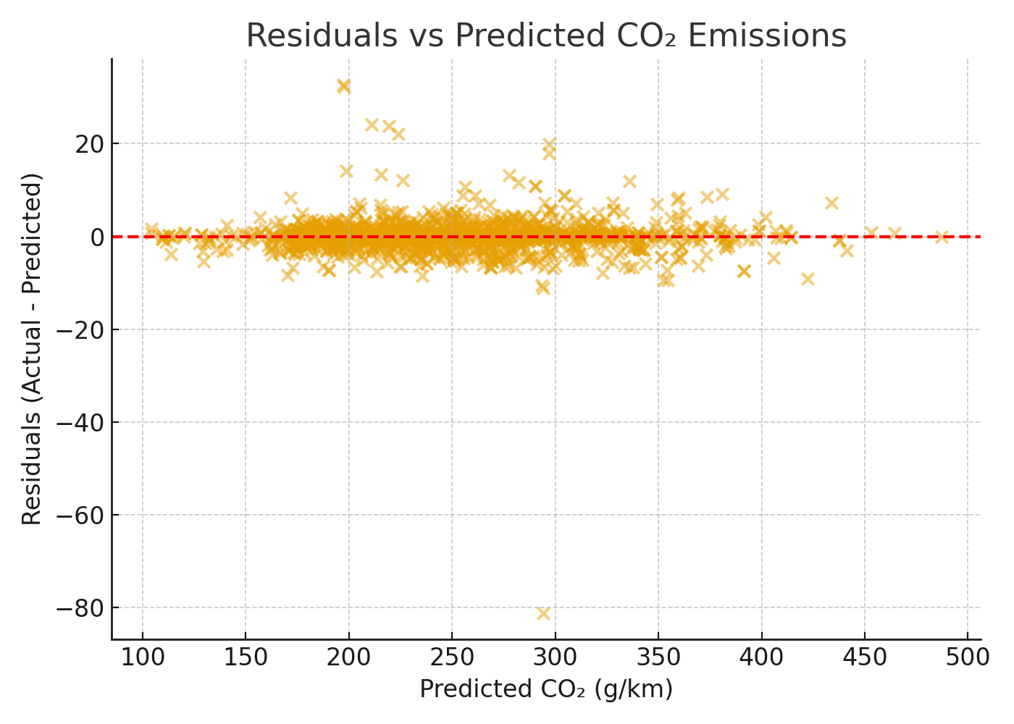
Evaluation — Residual Analysis
Residuals vs predicted values to check heteroscedasticity and biases.

Slide 20
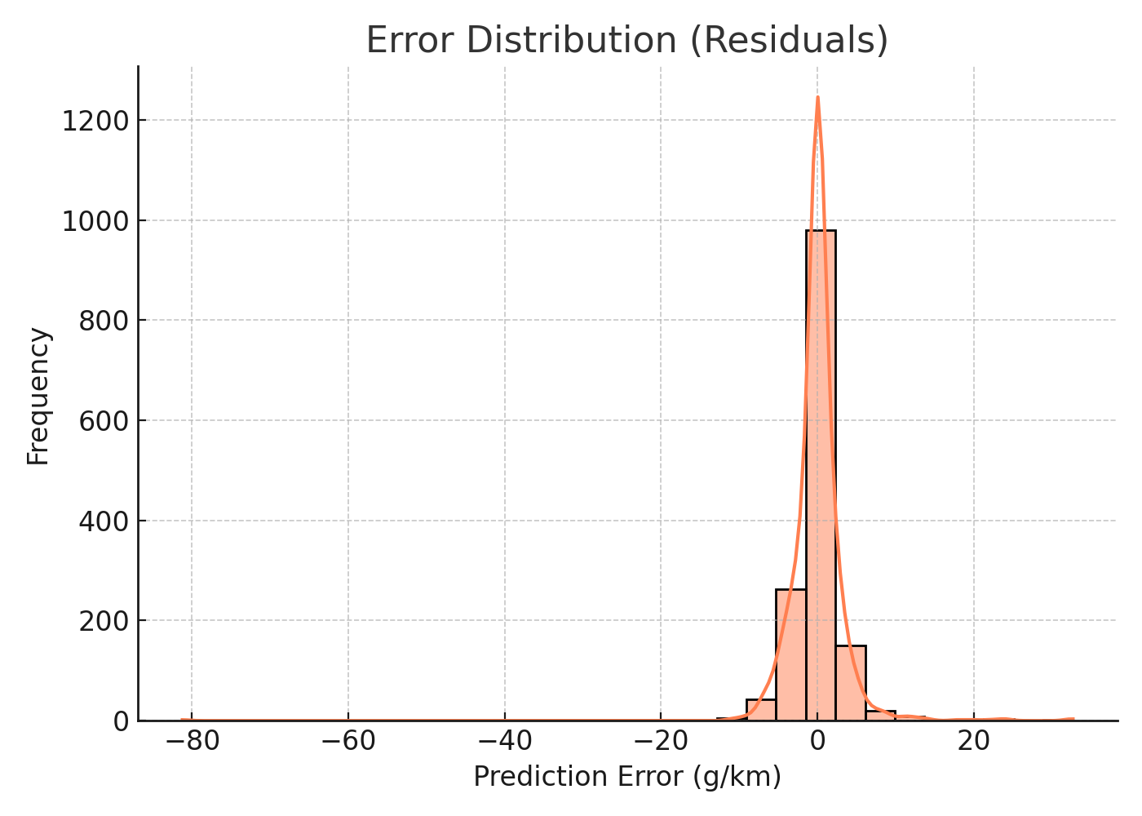
Evaluation — Error Distribution
Histogram / KDE of prediction errors (y_pred - y_true).

Slide 21
Model Limitations & Assumptions
Model performance depends on the quality of manufacturer-reported consumption numbers.
High-cardinality categorical fields (make/model) were treated conservatively — could be better represented with frequency encoding.
Results are valid within the distribution of the dataset — extrapolation to new vehicle types may be unreliable.

Slide 22
Deployment & App Overview
Local Streamlit app created for interactive predictions (input: make, model, engine size, fuel consumption, transmission, cylinders, fuel type).
App uses the trained Random Forest model and scaler to estimate CO₂ (g/km).
Backend files and encodings used in the app are available in the uploaded project files.

Slide 23
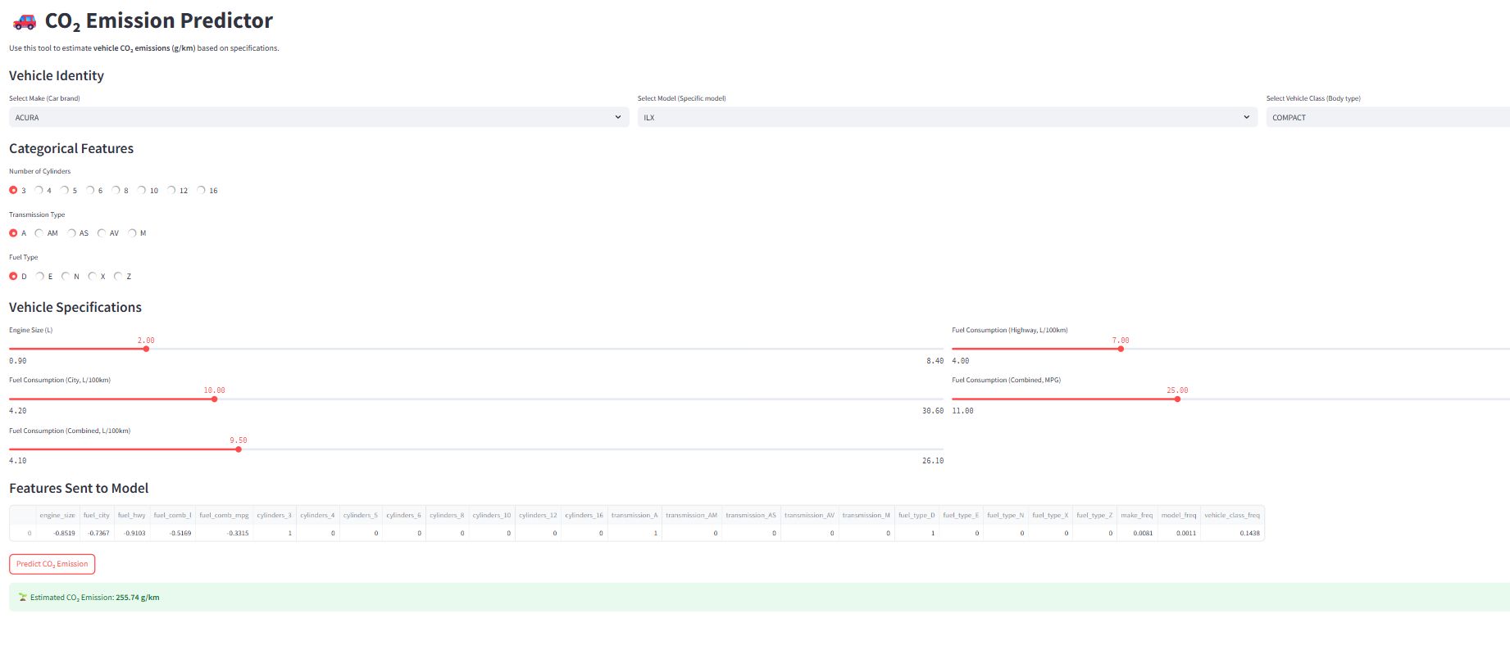
APP Page — Screenshot
Streamlit app main page showing inputs and predicted CO₂.

Slide 24
Challenges Faced
Handling high-cardinality categorical variables (make/model) without leaking information.
Feature engineering for fuel consumption units (MPG vs L/100 km).
Balancing model complexity and deployment performance for real-time app.

Slide 25
Future Work & Improvements
Explore target encoding / frequency encoding for make/model to retain information without exploding feature space.
Experiment with gradient boosting (XGBoost/LightGBM) and stacking ensembles for further gains.
Create automated CI/CD for model updates and monitor prediction drift post-deployment.

Slide 26
Project Artifacts & Files
Included: co2_emissions.csv, EDA CSV, Jupyter notebook, trained model files, Streamlit app code (rf.py).
Files are in the uploaded project folder—refer to them for reproduceability.

Slide 27
Thank You

